Slide 1
FAKE NEWS DETECTION

Slide 2
Group Member Information
1.Deepthi Bodapati (700734601)
2.Yeshwanth Reddy Kunam (700731889)
3.Bytinty Siva Prasad Reddy (700734604)
4.Mohith Medikonda (700734518)

Slide 3
Role/Responsibilities and Contribution in project
We have divided work in two groups:
Group 1: 1.Deepthi Bodapati (700734601) ,2.Yeshwanth Reddy Kunam (700731889)
(Data loading
Preprocessing
Use of Porterstemmer)
Group 2: 3.Bytinty Siva Prasad Reddy (700734604), 4.Mohith Medikonda (700734518)
(Vectorizer
Modeling
PPT Slides for Presentation
Report)

Slide 4
Motivation
Fake news detection has gained increasing importance among the research community due to the widespread diffusion of fake news through media platforms.
Many dataset have been released in the last few years, aiming to assess the
performance of fake news detection methods.
In this survey, we systematically review twenty-seven popular datasets for fake news detection by providing insights into the characteristics of each dataset and comparative analysis among them.

Slide 5
Objectives
In FAKEDETECTOR, the fake news detection problem is formulated as a credibility score inference problem, and FAKEDETECTOR aims at learning a prediction model to infer the credibility labels of news articles, creators and subjects simultaneously.

Slide 6
Related work
Experimentation into distinctive pretend news has been strenuous over the past few years. However, most of the add this field focuses on the thought of finding out whereas sleuthing bluffs their main distribution channel: social networks

Slide 7
Problem Statement
We have two datasets Fake and True,we need to detect the news as we know our problem statement is FAKE NEWS DETECTION , so we did some preprocessing, cleaning the data and make it compatible for modeling then use machine learning and use algorithm then it will give the best accuracy to us.

Slide 8

Proposed Solution
As we know we need to detect the news which one is true or which one is fake so we use model to get best accuracy in this case we use LOGISTIC REGRESSION to get the best accuracy.

Slide 9
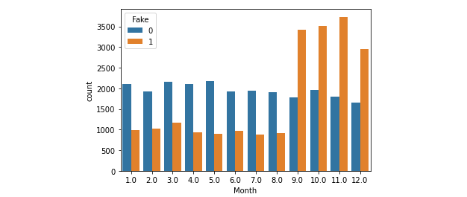
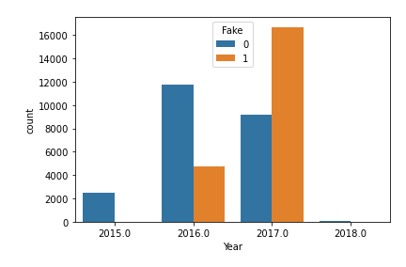
Results/Simulations
accuracy score of train data : 0.9900266686150586
accuracy score of test data : 0.9840606887146267

Slide 10
References
https://www.kaggle.com/
https://www.nltk.org/howto/stem.html
https://www.tutorialspoint.com/how-can-text-vectorization-be-applied-on-stackoverflow-question-dataset-using-tensorflow-and-python

